Slide 1
IBM University Engagement Project Submission
“Exploring the Power of Agentic AI with IBM Granite and IBM Bob”

Slide 2

Project Title-Document Q&A RAG Agent for Recipe Generator
Domain of Project – Food and Nutrition
Student Name | Recent Passport Photo | Email ID | Mobile number [WhatsApp]
Dharti Shahajirao jadhav |  | dhartijadhav01@gmail.com | 8660833802
Recommended font style and size:
Font Style: Arial
Font Size (Heading): 28
Font Size (Content): 20

Slide 3
Problem Statement -Q&A RAG A gent for Recipe Generator
The Challenge
Good cooking requires creativity and knowledge, but individuals struggle with recipe planning, ingredient substitution, and personalized cooking. Recipe information is scattered across unreliable sources.
The Objective
Build an AI-powered Q&A RAG Agent that delivers personalized recipe generation and cooking assistance.
Key Features:
• Personalized Recipe Generation – Based on ingredients, allergies, preferences
• Q&A RAG Retrieval – Answers cooking queries from reliable sources
• Ingredient Search – Input via text / image / voice
• Nutritional Focus – Calories, macros, vitamins
• Multi-Agent System: Recipe Knowledge Agent, Recipe Generator Agent, Q&A Advisory Agent
• Visualization Dashboard – Saved recipes, history

Slide 4
Problem Statement-AI-Powered Q&A RAG Recipe Generator Agent
The proposed solution is a multi-agent AI-powered Q&A RAG Recipe Generator built using IBM Bob, IBM watsonx.ai, and Granite Models to provide personalized, real-time recipe generation and cooking guidance. The system addresses challenges in meal planning, ingredient use, and preventive healthy cooking through an intelligent, modular architecture.
At its core, the solution uses a Retrieval-Augmented Generation (RAG) pipeline to fetch accurate recipe data from trusted sources such as curated recipe datasets, food blogs, and USDA nutrition.
The system consists of four key agents:
- Recipe Knowledge Agent retrieves and summarizes nutritional & recipe info using RAG.
- Recipe Recommendation Agent generates personalized recipes based on user inputs such as available ingredients, age, health conditions, dietary preferences, cooking time, and fitness goals.
-Health & Q&A Advisory Agent provides preventive cooking suggestions and answers queries like substitutions
- Food Log & Feedback Agent allows users to log meals via text, voice, or images and delivers instant nutritional analysis with actionable feedback.
Overall, this solution delivers an end-to-end intelligent recipe assistant that promotes healthier lifestyles through personalized insights, real-time feedback, and creative cooking.

Slide 5
Technology Used - Q&A RAG Agent for Recipe Generator
IBM Bob platform – For designing and orchestrating multi-agent workflows visually for recipe generation and Q&A flow.
IBM Granite model - for eg – ibm-granite-3-2-8b – For natural language understanding, recipe reasoning, ingredient substitution, and personalization.
IBM Cloud – It provides the infrastructure to build, deploy, and scale the Recipe Generator Agent efficiently. IBM Cloud enables a reliable, secure, and scalable environment for deploying the Q&A RAG Recipe Agent.
RAG – RAG to fetch real recipe data first, then generate intelligent answers & recipes, making the Recipe Agent more trustworthy and effective (no hallucinations).
IBM Watsonx.ai - For model deployment, embeddings, prompt tuning, and AI governance for recipe data.
Vector Database (FAISS / Chroma) – For RAG-based recipe & nutritional data retrieval from curated recipe datasets and USDA food data.

Slide 6
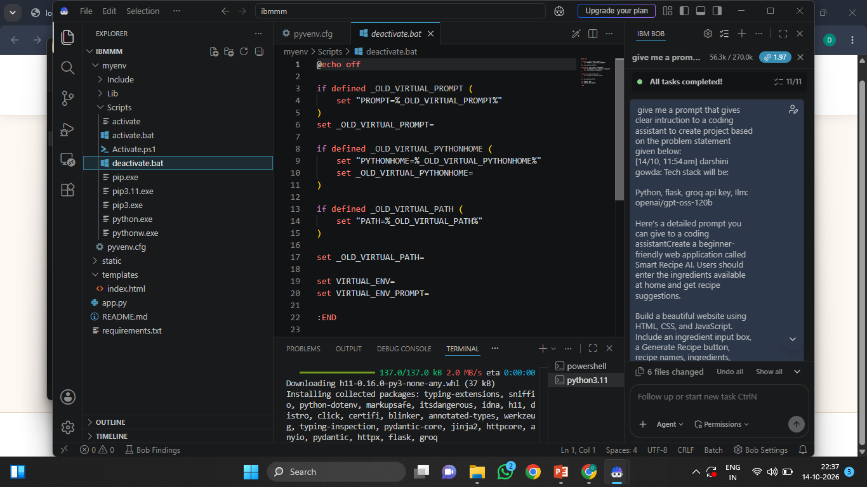
Required Files created using IBM bob -
App.py
Requirements.txt
Style.css
.env
Index.html

Slide 7
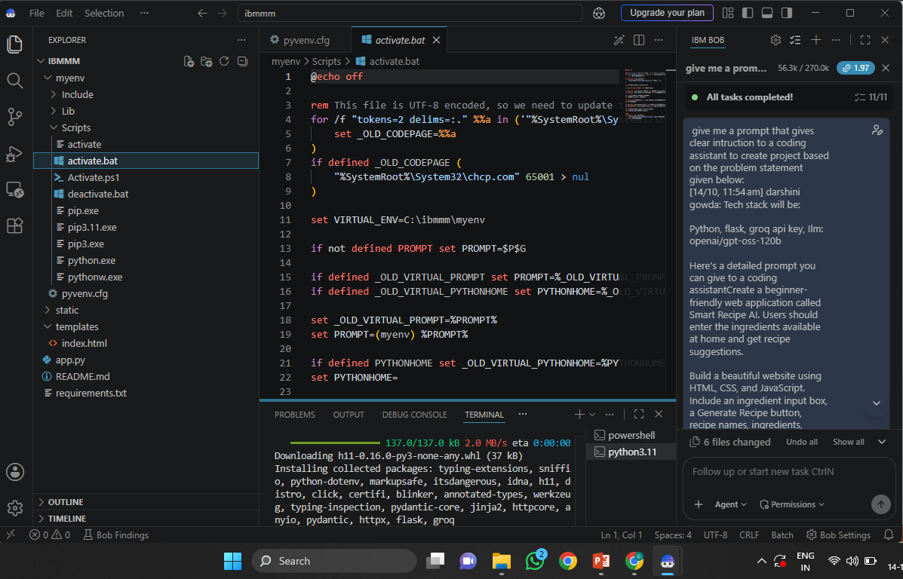
IBM Bob Screenshots:

Slide 8
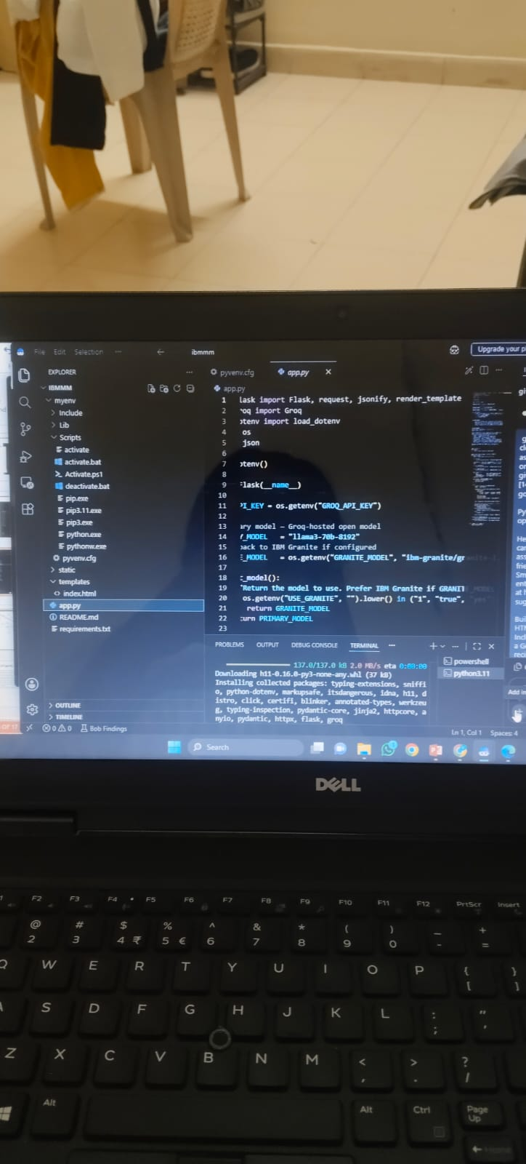

Slide 9
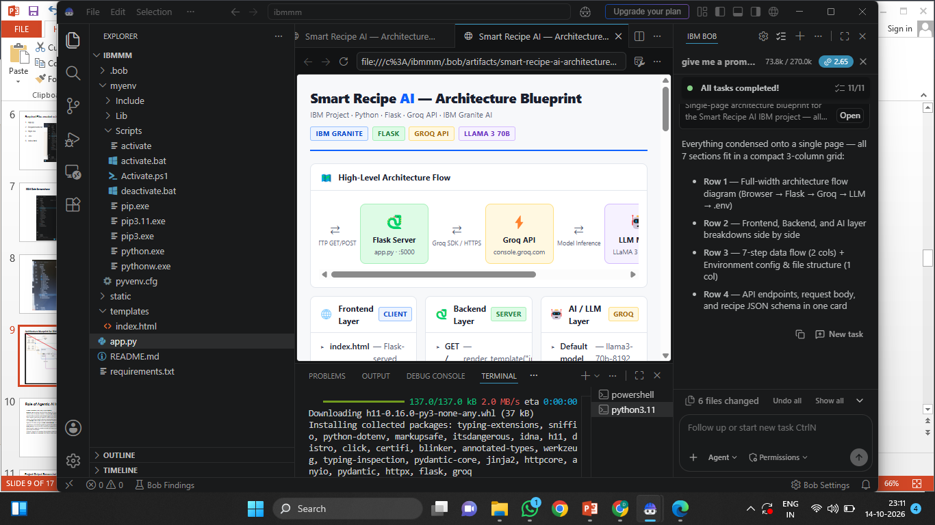
Architecture blueprint for IBM bob:

Slide 10

Role of Agentic AI in the solution
Role of Agentic AI in Nutrition Agent
Agentic AI enables the Nutrition Agent to function as an intelligent, autonomous system rather than a simple chatbot. Using IBM watsonx.ai and IBM Granite models, it coordinates multiple specialized agents to deliver personalized nutrition guidance.
Each agent performs a specific role—such as retrieving nutritional data, generating diet plans, providing health advice, and analyzing food logs—while working collaboratively. This multi-agent approach ensures efficient task execution and accurate results.
Agentic AI also brings context awareness, understanding user details like age, health conditions, and fitness goals to generate tailored recommendations. It supports real-time adaptation, continuously updating suggestions based on user inputs like daily meals.
Additionally, agents communicate with each other, enabling better decision-making and improved outcomes.
Overall, Agentic AI makes the system proactive, personalized, and goal-driven, acting like a smart digital nutritionist that helps users maintain a healthy lifestyle.

Slide 11
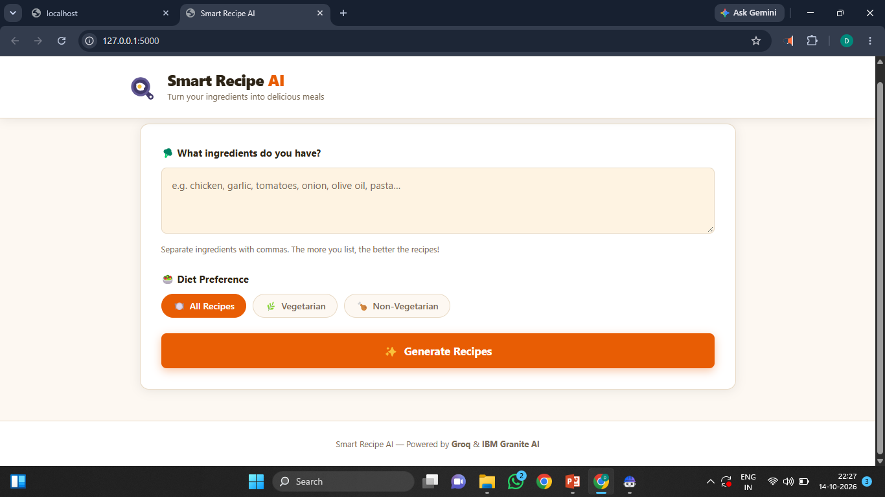
Project Output Screenshot
·
·
·

Slide 12
Project Output Screenshot
·
·
·

Slide 13
Novelty and Uniqueness
The proposed Nutrition Agent stands out by combining Agentic AI, RAG, and personalization into a single intelligent system.
Multi-Agent Intelligence – Instead of a single chatbot, multiple specialized agents collaborate to deliver accurate and context-aware nutrition guidance.
RAG-Based Accuracy – Integrates real-time data retrieval with AI generation, reducing misinformation and ensuring trustworthy recommendations.
Hyper-Personalization – Tailors diet plans based on health conditions, cultural preferences, and fitness goals.
Real-Time Feedback Loop – Continuously adapts recommendations based on daily food logs and user behavior.
Multi-Modal Input – Supports text, voice, and image-based meal tracking for better usability.
Preventive Healthcare Focus – Goes beyond diet planning to provide disease-specific nutrition advice.
Scalable & Enterprise-Ready – Built on IBM watsonx.ai with IBM Granite models, ensuring reliability and governance.
This makes the solution a smart, adaptive, and proactive digital nutritionist, not just a static diet recommendation tool.

Slide 14
GIT Hub Link

Slide 15
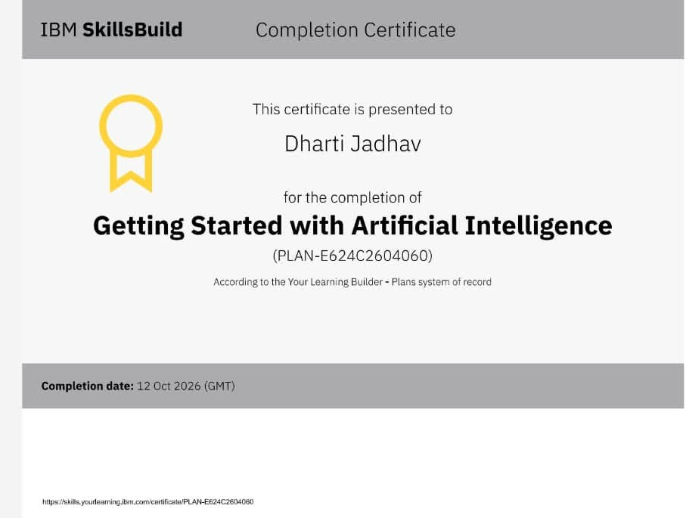
Certificates Earned:​
Add your IBM BOB Certificate

Slide 16
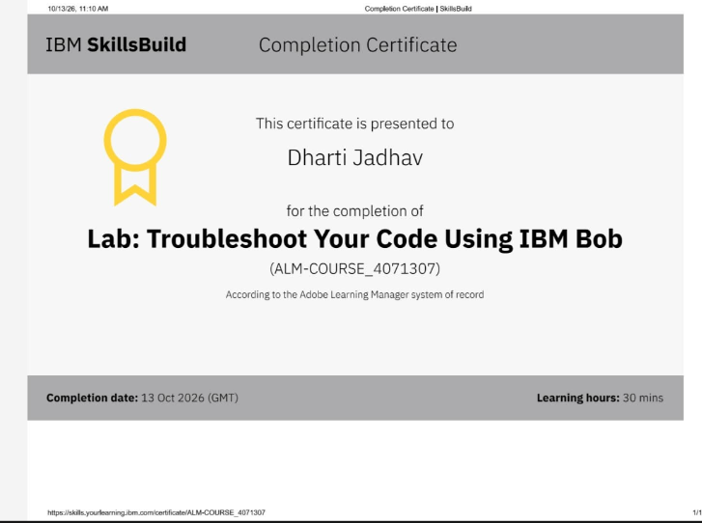
Certificates Earned:

Slide 17


